Slide 1
Chapter 12: Trends in hominid evolution

Slide 2
12.1 Humans as primates
Humans, apes, monkeys and some other related animals are called primates because they are all classified together in the taxonomic order Primates. The non-human primates are the closest living relatives of our own species. A comparative study of primates is fundamental to any investigation of the evolution of modern humans. In trying to develop an understanding of how human characteristics evolved, a number of sources of evidence can be used:
• comparative anatomy
• comparative biochemistry, including DNA and proteins
• behaviour of living primates
• fossils of primates.
Humans are classified in the same family as the great apes: chimpanzees, bonobos, gorillas and orangutans. The great apes share the most recent common ancestor with humans and, therefore, share many of our characteristics, including very similar DNA.

Slide 3
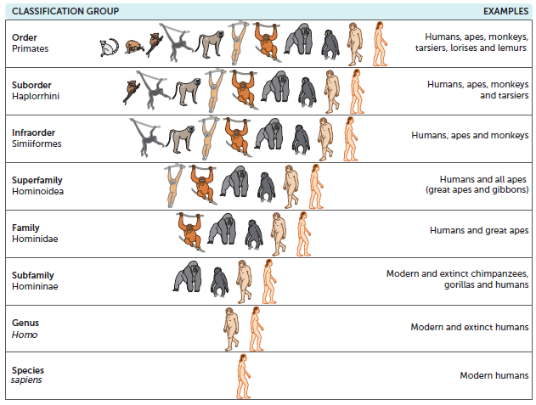
12.1 Humans as primates
Diagrammatic representation of the hierarchy within the Primate order

Slide 4
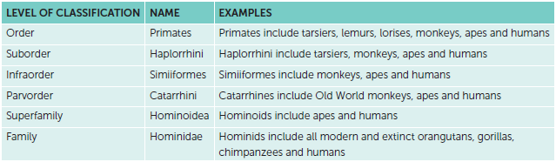
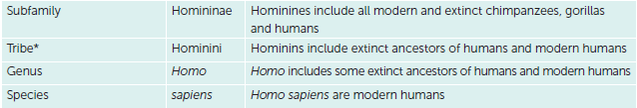
12.1 Humans as primates
Classification of humans within the Primate order

Slide 5
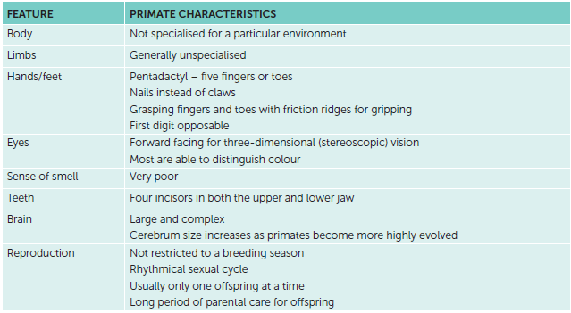
12.1 Humans as primates
Characteristics of primates
There is no one characteristic that can be used to separate the primates from all other mammals. However, some features shared by all primates can be used to identify them as a group. Most of these features are a result of primates having evolved in an arboreal, or tree-like, environment. Two of these, grasping fingers and toes and overlapping vision, when taken together are distinctive to the primates. The table summarises the characteristics of primates.

Slide 6
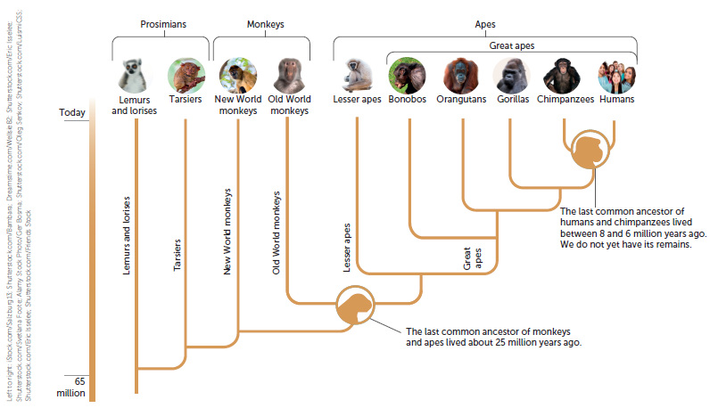
12.2 Variation within the family Hominidae
Humans are in the same family as the great apes (orangutans, gorillas, chimpanzees and bonobos). This family is called Hominidae, and its members are called hominids.
Left to right: iStock.com/Salzburg13; Shutterstock.com/Bambara; Dreamstime.com/Wellsie82; Shutterstock.com/Eric Isselee;
Shutterstock.com/Svetlana Foote; Alamy Stock Photo/Ger Bosma; Shutterstock.com/Oleg Senkov; Shutterstock.com/LuismiCSS;
Shutterstock.com/Eric Isselee; Shutterstock.com/Friends Stock

Slide 7
12.2 Variation within the family Hominidae
All species in the family Hominidae share some characteristics. These include:
a larger, more complex brain than other primates. This enables an increased cognitive ability that means they can recognise themselves in a mirror
five cusps in the molar teeth of the lower jaw
arms that can freely rotate at the shoulder
a wide, shallow chest cavity
no external tail
an appendix
being active during the day (diurnal).

Slide 8
12.2 Variation within the family Hominidae
There are also some variations that reflect changes in the DNA nucleotide sequences during evolution. Some of these changes relate to:
• relative size of the cerebral cortex
• mobility of the digits
• locomotion – adaptations to bipedalism and quadrupedalism
• prognathism and dentition.

Slide 9
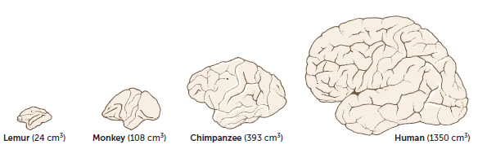
12.2 Variation within the family Hominidae
Changes in the relative size of the cerebral cortex
In the primates, the part of the brain responsible for complex functions, the cerebrum, has progressively increased in size. This is especially true of the cerebral cortex. It is this region of the brain that is concerned with so-called higher functions – vision, memory, reasoning and manipulative ability.
The diagram shows the increase in size and complexity of the cerebrum from lemurs to humans. This is one of the most significant features of primate evolution.

Slide 10
12.2 Variation within the family Hominidae
Primates have large brains for their body size. This seems to be a consequence of their tree-dwelling environment. The pressure of natural selection in an arboreal environment would have favoured more accurate visual and tactile perception along with better coordination between such sensory stimuli and any muscular response. In primate brains, such operations are carried out by the cerebral cortex. Progressive expansion of the cerebral cortex has resulted in it becoming so large that it covers the rest of the brain. This is most noticeable in humans.
Humans’ brains range in size from 900 cm³ to 2200 cm³, but average around 1350 cm3 in adulthood. This contrasts markedly with those of the other apes, which average between 400 cm³ and 500 cm³. Most of the difference in brain size is associated with the cerebrum, especially the cerebral cortex.
Compared with other apes, the front part of the cerebrum, known as the frontal lobe, has the greatest enlargement in surface area. In humans it makes up 47% of the total cortical surface, whereas in apes it comprises only 33%. It is in the frontal lobe that the higher functions of thinking, reasoning, planning and processing take place.

Slide 11
12.2 Variation within the family Hominidae
The brains of hominids have a strong pattern of convolutions. These convolutions, or folds, enable the surface area of the brain, and hence the cerebral cortex, to be greatly increased (see previous diagram). These convolutions have resulted in a 50% increase in the surface area of the human brain compared with what it would be on a brain with no convolutions.
The increase in size of the cerebral cortex has had far-reaching effects on the way primates live. It has enabled them to move about and locate food, and to develop special skills. One of the most significant of these is tool making. This ability is most highly developed in humans, but is also seen in chimpanzees. Tool making, as opposed to tool use, involves a predetermined image of what the completed tool should look like – something only possible with a highly developed brain.

Slide 12
12.2 Variation within the family Hominidae
A large brain requires a large brain case, or cranium, and in humans more of the skull is used in housing the brain than in the other apes. As a consequence, the brow tends to be vertical and lacks the prominent brow ridges possessed by the apes. These features, together with a shortening of the snout, have given humans a flat face, although the bones of the nose still protrude. For this reason, humans have a far more prominent nose than any other primate.
The brains of early hominins have not been fossilised, but because the brain fills the whole of the cranium, brain size can be determined by measuring the volume inside the cranium using an endocast. This capacity is known as cranial capacity.

Slide 13
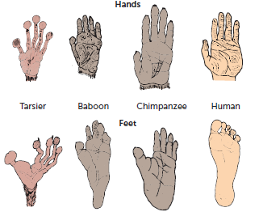
12.2 Variation within the family Hominidae
Mobility of the digits
The limbs of primates are pentadactyl, which means they have five digits on each limb. The digits are highly mobile, a feature that can be related to the arboreal way of life of primate ancestors. The evolutionary trend is towards increasing ability to move the digits independently of one another. The most highly developed digits in this respect are the thumb and the big toe. Not only are they independent, but they are also opposable in most primates. Opposability means that the first digit can be moved in such a way that it can touch each of the other digits.
The degree of opposability varies from species to species and depends on the relative length of the first digit compared with the other four. Almost all species of primate show some opposability of the big toe, with humans being the one exception.

Slide 14
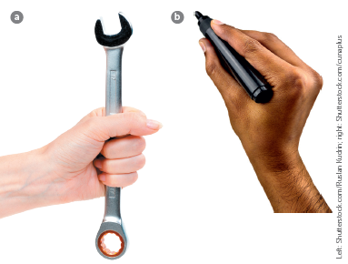
12.2 Variation within the family Hominidae
Having highly mobile digits has enabled humans, more than any of the other primates, to manipulate objects with great skill. The human hand is short and broad, with short, straight fingers and a long, strong thumb.
This arrangement gives the thumb a great degree of freedom, and it can readily oppose each of the other digits, thumb tip to fingertip, allowing humans to grasp objects using the precision grip (b). This enables humans to handle small or delicate objects effectively.
The power grip (a) happens when the thumb and fingers apply force against the palm. The precision grip requires the presence of a truly opposable thumb and is also seen in Old World monkeys, particularly the ground-living baboons, mandrills and macaques.
Left: Shutterstock.com/Ruslan Kudrin; right: Shutterstock.com/cunaplus

Slide 15
12.2 Variation within the family Hominidae
Locomotion – adaptations to bipedalism and quadrupedalism
During evolution, there has been a change from quadrupedalism (walking on four limbs) to bipedalism (walking on two legs). This is a major distinguishing feature of hominins and is used by scientists when classifying fossils.
For humans to be able to stand on two legs and walk bipedally with a striding gait, the skeleton and muscles had to evolve. Compare the skeletons of the gorilla and human in the next slide. The differences seen have evolved over millions of years, so that present-day humans can stand and walk erect on two legs. This adaptation helped our human ancestors to survive, and hence has acted as a selective pressure during natural selection.

Slide 16
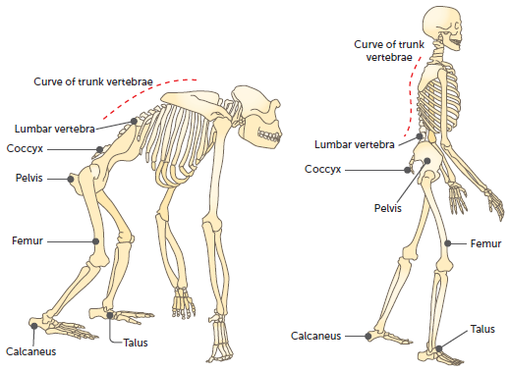
12.2 Variation within the family Hominidae

Slide 17
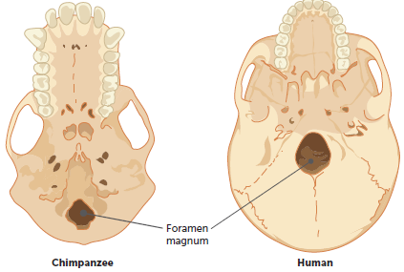
12.2 Variation within the family Hominidae
Position of the foramen magnum
Where the brain joins the spinal cord there is a hole in the skull called the foramen magnum. During the evolution of modern humans from an ape-like ancestor, the foramen magnum has gradually moved forward to become more central. This allows the skull to balance on top of the vertebral column. An ape like a gorilla needs large neck muscles to hold the head in position. In humans, the weight of the skull is borne by the vertebral column and so large neck muscles are not required.

Slide 18
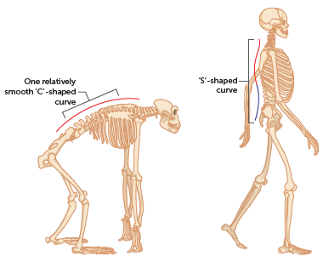
12.2 Variation within the family Hominidae
Curvature of the spinal column
During evolution, the curvature of the spine has changed to allow an upright posture. The smooth ‘C’-shaped curve seen in the spines of apes such as gorillas has evolved to an ‘S’-shaped curve in humans. This improves the body balance in the upright position and enables the head to balance on top of the neck.
In humans, the double curvature is achieved by the vertebrae in the lower, or lumbar, region being wedge-shaped from front to back, thus forming a forward-jutting curve. In addition, the cervical curve in the neck brings the vertebral column directly under the centre of gravity of the skull.

Slide 19
12.2 Variation within the family Hominidae
The jaw
Apes have a protruding jaw, known as prognathism, whereas in humans the facial profile is much flatter. During evolution from an ape-like ancestor, the size and protrusion of the human jaw has gradually been reduced. This change has been important in allowing the skull to balance on the top of the spine, because the weight in front of the foramen magnum is approximately equal to the weight behind it. Balance is thus achieved with a minimum of muscular effort.

Slide 20
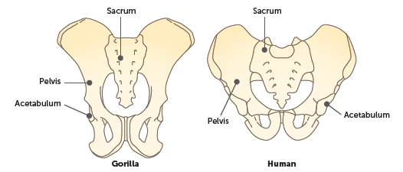
12.2 Variation within the family Hominidae
The pelvis
At its lower end, the vertebral column articulates with the pelvis. The pelvis in humans is broader, and shorter from top to bottom, than in apes, and bowl-shaped. This bowl shape supports the abdominal organs when standing erect, provides greater stability for bipedal locomotion and, in the female, supports the developing foetus during pregnancy. The female pelvis tends to be slightly broader than that of the male to allow for the passage of the infant at birth.
The broad hip bones provide space for attachment of the large buttock muscles, which move the legs and keep the upper body erect.

Slide 21
12.2 Variation within the family Hominidae
The carrying angle
In humans, the shape and orientation of the pelvis result in the hip joint being directly under the trunk and head. This allows the weight of the body to be transferred from the pelvis to the legs. The head of the femur, or thigh bone, is large and fits into the acetabulum (hip socket) of the pelvis. Because the pelvis is broad, the hip sockets are wide apart, but the femurs tend to converge towards the knees. This arrangement of the femurs forms an angle to the vertical, termed the carrying angle, which ensures that weight distribution remains close to the central axis of the body when walking.
In humans the weight tends to fall through the outside of the femur, whereas in other apes the reverse is true.
The carrying angle allows for greater stability in an upright posture. When walking, it enables the body to be rotated about the lower leg and foot, and each footstep follows a more-or-less straight line. This enables humans to have a striding gait instead of swaying from side to side as do gorillas or chimpanzees when walking on two legs.

Slide 22
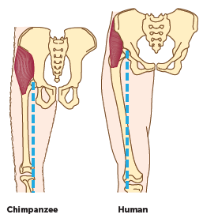
12.2 Variation within the family Hominidae
Pelvises and femurs of chimpanzees and humans, showing how humans have a carrying angle, with the femur angled in towards the knee (the dotted line shows the direction of weight transmission)

Slide 23
12.2 Variation within the family Hominidae
The knee
In bipedal species, the weight of the body is transmitted down the outside of the femur to the knee. The knee joint is a two-part hinge joint, with one ‘hinge’ on either side of the ligaments in the middle of the joint. Because the weight is transmitted to the outer ‘hinge’, it is larger and stronger than the inner one.
Although the weight of the body is transmitted down the outside of each leg, the centre of gravity of the body tends to fall through a line just in front of the knees. This results in a force that tries to bend the knee backward but is resisted by the ligaments making up the knee joint. This natural resistance produces a joint that requires no energy to support the body in a standing position.

Slide 24
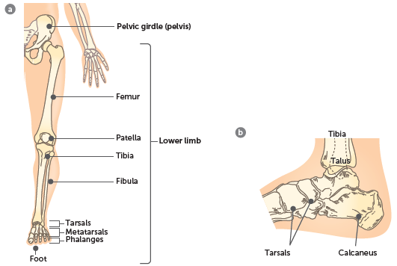
12.2 Variation within the family Hominidae
The foot
From the knee joint, most of the weight of the body is transmitted through the tibia to the ankle. The tibia is the larger and stronger of the two lower leg bones. At the ankle, body weight is transmitted from the tibia through the talus (ankle bone) to the other tarsal bones, then to the metatarsals and phalanges via the arches of the foot.
a Lower limb showing the weight-bearing bones; b Tarsal bones of the foot

Slide 25
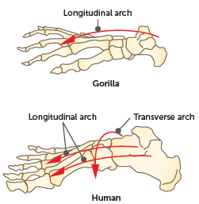
12.2 Variation within the family Hominidae
The human foot is one of the most distinctive adaptations for bipedal locomotion. In becoming a highly specialised locomotory organ it has lost its grasping ability, or prehensility. This is most noticeable with the big toe, which in humans is quite large and aligned alongside the other toes. The bones of the foot between the toes and the ankle, the metatarsals, are shaped in such a way that they form two arches: a longitudinal arch running from front to back, and a transverse arch running from side to side.
The transverse arch is unique to humans. These two arches have enabled humans to perfect bipedal locomotion.

Slide 26
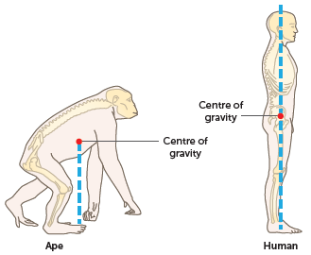
12.2 Variation within the family Hominidae
Centre of gravity
Unlike other apes, humans have legs that are longer than the arms. The relatively long legs increase the length of the stride when walking. Surprisingly, they also serve to lower the centre of gravity of the body, the point at which all the weight of the body appears to be concentrated. In contrast to humans, where almost half the total height is in leg length, in apes only about one-third of the total height is taken up in leg length. This results in their centre of gravity being further up the body. Whereas the centre of gravity for the ape is at chest level, for humans it is at the level of the pelvis. The lower centre of gravity in humans contributes to stability when moving bipedally or when standing erect.

Slide 27
12.2 Variation within the family Hominidae
Muscle tone
One of the essential elements for maintaining an upright stance is muscle tone. Muscle tone is the partial contraction of skeletal muscles. For example, to keep the head erect and stop it from slumping forward on to the chest, the muscles in the back of the neck are partially contracted; that is, they have tone. If someone falls asleep while sitting up, the decrease in tone is evident as the head nods until the chin is close to the chest.
Sustained muscle tone is most evident in those muscles that support the body in an upright position. In humans, the muscles that do this are those that bring about movement of the spine, hip, knee and ankle, and also the abdominal muscles. The nervous system and a variety of sense organs work together to maintain the tone in these muscles and the equilibrium of the body.

Slide 28
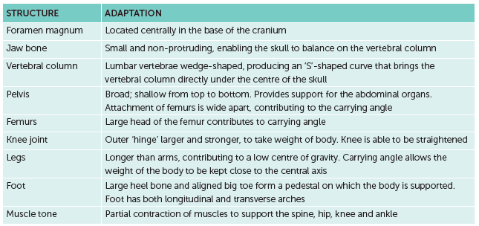
12.2 Variation within the family Hominidae
Summary of the main hominin adaptations for erect posture

Slide 29
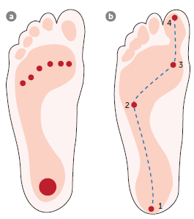
12.2 Variation within the family Hominidae
Striding gait
Walking upright in such a way that the hip and knee are fully straightened is referred to as the striding gait. Hominins are the only animals that have perfected this form of locomotion.
In the striding gait, when the foot hits the ground, weight is transmitted from the heel along the outside of the foot as far as the ball, crosses the ball of the foot (via the transverse arch) and is finally borne by the big toe. At the final moment of striding, the whole weight of the body is propelled by the big toe.
a How body weight is borne by the foot when standing still; b The distribution of body weight as a step is taken

Slide 30
12.2 Variation within the family Hominidae
When walking, the trunk rotates about the pelvis. The forward swinging of the arms compensates for this natural rotation of the body: the right arm naturally swings forward as the left leg is extended, and vice versa. Swinging of the arms tends to keep the shoulders at right angles to the direction of travel, and reduces the amount of energy expended. If the arms did not move as they do, energy would be wasted in reversing the rotation of the body after each stride.
The arrangement of the femurs ensures that weight distribution remains close to the central axis of the body during walking. The arrangement also allows for stability during walking, as the body can be rotated about the lower leg and foot, thus allowing each footstep to follow a more-or-less straight line. Apes such as chimpanzees lack a wide pelvis and carrying angle. When walking on two legs they must sway from side to side so that the body weight is over each leg in turn.

Slide 31
12.2 Variation within the family Hominidae
Advantages of bipedalism
Evolutionary trends arise due to a selective advantage leading to natural selection. In the case of bipedalism, there are a number of possible advantages, including:
• It is a more energy-efficient means of moving.
• It leaves the hands free to use tools.
• It leaves the hands free to carry items.
• The upright stance achieves greater height and thus the ability to see further.
• The upright stance means that less of the body is exposed to sunlight.
• The upright stance increases exposure to breezes, increasing cooling mechanisms.

Slide 32
12.2 Variation within the family Hominidae
Prognathism and dentition
Number and shape of teeth
The number of each type of tooth that a species has can be expressed as a dental formula. The formula gives the number of each type of tooth in one quarter of the jaw. Primitive mammals had a dental formula of 3:1:4:3. This means that there are 44 teeth: three incisors, one canine, four premolars and three molars on each side of each jaw.
Natural selection has resulted in a decrease in the number of teeth in primates compared with early mammals. This is probably related to the gradual reduction in the size of the face and jaw that has occurred in primates that allows the skull to balance during bipedalism. Old World monkeys, apes and humans all have 32 teeth and a dental formula of 2:1:2:3; however, there is considerable difference between them in the structure and arrangement of the teeth.

Slide 33
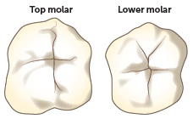
12.2 Variation within the family Hominidae
In the Old World monkeys and apes, the canines are usually large and sharply pointed, projecting beyond the level of the other teeth. Such large canines have required modifications to adjacent teeth so that the mouth can be closed. Most primates with large canines have a gap, or diastema, between the upper second incisor and the upper canine to accommodate the large lower canine. To allow for the large upper canine, the crown of the first lower premolar is slanted back and has a sharp edge. The upper canine fits tightly against this premolar and is sharpened by the grinding that occurs.
The surface of the molars of apes and humans has evolved from the three cusps of early mammals to four cusps on the upper molars and five cusps on the lower ones. This pattern has been useful in identifying the teeth of fossil apes and humans, and is presumed to have evolved due to the predominantly fruit diet of the apes.

Slide 34
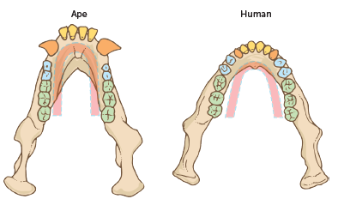
12.2 Variation within the family Hominidae
Compared with other primates, human dentition is very distinctive. In humans the canine teeth do not project beyond the level of the other teeth and interlock, as they do in the Old World monkeys and apes. They are more even in size, looking more like incisors. These small canine teeth and relatively small incisors take up less room in the jaw. As a consequence, the shape of the tooth row, or dental arcade, has evolved into a different shape. Instead of the ‘U’ pattern of the apes, it has become parabolic in shape.

Slide 35
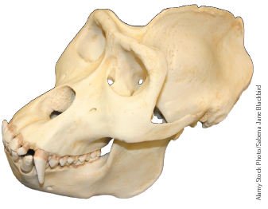
12.2 Variation within the family Hominidae
Prognathism and brow ridges
Non-human apes and the early hominins have a forward-jutting jaw, a characteristic known as prognathism, and a distinct brow ridge, the bony ridge located above the eye sockets, very evident in adult gorillas. With evolution, the tooth size gradually decreased leading to a flattening of the face, development of a chin and a prominent nose. With the move to bipedalism, a flatter face shifts the weight to a more central position, allowing the skull to balance during an upright stance. And as the size of the frontal lobe has increased, the brain occupies a larger volume, extending the cranium forward and reducing the brow ridges.
Alamy Stock Photo/Sabena Jane Blackbird

